Slide 1
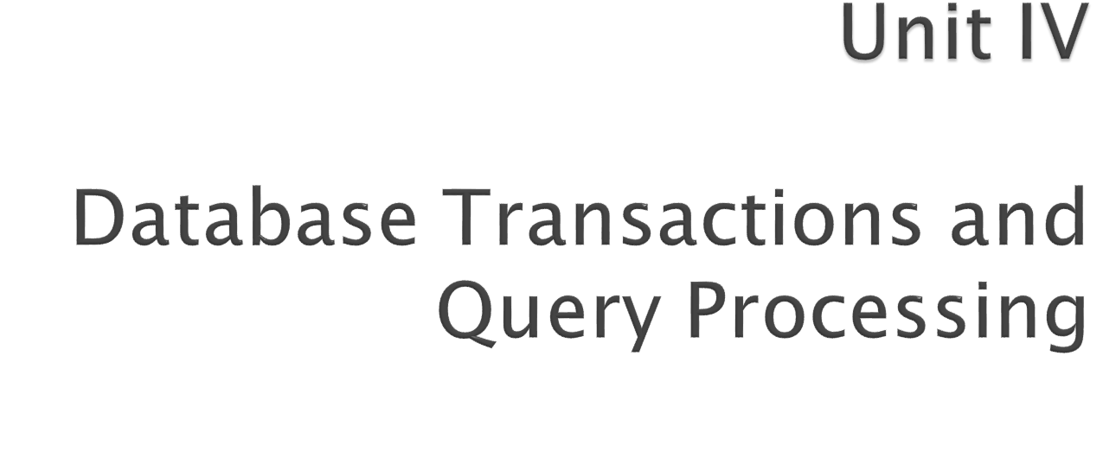
Prepared By:
Prof. S. M. Shedole
SIT, Lonavala
Notes:
Poonam Railkar, SKNCOE

Slide 2
Transaction Management
Concurrency Control,
Recovery system
Query processing
Query Optimization
Performance Tuning

Slide 3

Transaction Concept
Transaction State
Concurrent Executions
Serializability
Recoverability
Implementation of Isolation
Testing for Serializability.

Slide 4

A transaction is a unit of program execution that accesses and possibly updates various data items.
E.g. transaction to transfer $50 from account A to account B:
  1. read(A)
  2. A := A – 50
  3. write(A)
  4. read(B)
  5. B := B + 50
  6. write(B)
Two main issues to deal with:
  Failures of various kinds, such as hardware failures and system crashes
  Concurrent execution of multiple transactions

Slide 5

To preserve the integrity of data the database system must ensure:
Atomicity. Either all operations of the transaction are properly reflected in the database or none are.
Consistency. Execution of a transaction in isolation preserves the consistency of the database.
Isolation. Although multiple transactions may execute concurrently, each transaction must be unaware of other concurrently executing transactions. Intermediate transaction results must be hidden from other concurrently executed transactions.
  That is, for every pair of transactions T_{i} and T_{j}, it appears to T_{i} that either T_{j}, finished execution before T_{i} started, or T_{j} started execution after T_{i} finished.
Durability. After a transaction completes successfully, the changes it has made to the database persist, even if there are system failures.

Slide 6

Transaction to transfer $50 from account A to account B:
  1. read(A)
  2. A := A – 50
  3. write(A)
  4. read(B)
  5. B := B + 50
  6. write(B)
Atomicity requirement
  if the transaction fails after step 3 and before step 6, money will be “lost” leading to an inconsistent database state
    Failure could be due to software or hardware
  the system should ensure that updates of a partially executed transaction are not reflected in the database
Durability requirement — once the user has been notified that the transaction has completed (i.e., the transfer of the $50 has taken place), the updates to the database by the transaction must persist even if there are software or hardware failures.

Slide 7

Transaction to transfer $50 from account A to account B:
  1. read(A)
  2. A := A – 50
  3. write(A)
  4. read(B)
  5. B := B + 50
  6. write(B)
Consistency requirement in above example:
  the sum of A and B is unchanged by the execution of the transaction
In general, consistency requirements include
    Explicitly specified integrity constraints such as primary keys and foreign keys
    Implicit integrity constraints
      e.g. sum of balances of all accounts, minus sum of loan amounts must equal value of cash-in-hand
  A transaction must see a consistent database.
  During transaction execution the database may be temporarily inconsistent.
  When the transaction completes successfully the database must be consistent
    Erroneous transaction logic can lead to inconsistency

Slide 8

Isolation requirement — if between steps 3 and 6, another transaction T2 is allowed to access the partially updated database, it will see an inconsistent database (the sum A + B will be less than it should be).
T1 T2
  1. read(A)
  2. A := A – 50
  3. write(A)
  read(A), read(B), print(A+B)
  4. read(B)
  5. B := B + 50
  6. write(B
Isolation can be ensured trivially by running transactions serially
  that is, one after the other.
However, executing multiple transactions concurrently has significant benefits, as we will see later.

Slide 9

Active – the initial state; the transaction stays in this state while it is executing
Partially committed – after the final statement has been executed.
Failed -- after the discovery that normal execution can no longer proceed.
Aborted – after the transaction has been rolled back and the database restored to its state prior to the start of the transaction. Two options after it has been aborted:
  restart the transaction
    can be done only if no internal logical error
  kill the transaction
Committed – after successful completion.

Slide 10



Slide 11
Multiple transactions are allowed to run concurrently in the system.
Advantages are:
  Increased processor and disk utilization, leading to better transaction throughput
    E.g. one transaction can be using the CPU while another is reading from or writing to the disk
  Reduced average response time for transactions: short transactions need not wait behind long ones.
Concurrency control schemes – mechanisms to achieve isolation
  ie, to control the interaction among the concurrent transactions in order to prevent them from destroying the consistency of the database

Slide 12

Schedule – a sequences of instructions that specify the chronological order in which instructions of concurrent transactions are executed
  a schedule for a set of transactions must consist of all instructions of those transactions
  must preserve the order in which the instructions appear in each individual transaction.
A transaction that successfully completes its execution will have a commit instructions as the last statement
  by default transaction assumed to execute commit instruction as its last step
A transaction that fails to successfully complete its execution will have an abort instruction as the last statement

Slide 13

Let T₁ transfer $50 from A to B, and T₂ transfer 10% of the balance from A to B.
A serial schedule in which T₁ is followed by T₂ :

Slide 14


A serial schedule where T₂ is followed by T₁

Slide 15


Let T₁ and T₂ be the transactions defined previously. The following schedule is not a serial schedule, but it is equivalent to Schedule 1.
In Schedules 1, 2 and 3, the sum A + B is preserved.

Slide 16


The following concurrent schedule does not preserve the value of (A + B ).

Slide 17

1.Explain different Database transaction States.
2.Explain ACID property.
3.What is a schedule?

